Slide 1
Module 2: Introduction to Neural Network
Introduction
Fundamental Concept
Evolution of Neural Networks
Biological Neurons
Artificial Neural Networks
NN Architecture
Activation Functions
McCulloch-Pitts Model
University Question Paper Weightage:
May 2019: 5 Marks
Dec 2019: 15 Marks

Slide 2
Introduction
Modern digital computers are truly astounding in the matter of power and speed.
Humans are not so intelligent to compute millions of mathematical operations in a second.
Humans cannot search a particular document from among the millions in a computer, whereas a computer can do it in a milliseconds.
However, there are some tasks where even the most powerful computers cannot compete with the human brain.
Example:
Human beings are good in narration, while computers are good in logic and mathematics.
The art of storytelling which humans have is not possessed by a computer.

Slide 3
Basic Concept of Neural Network
Is a information processing system
Constructed and implemented to model a human brain
Objective: Perform various computational tasks at a faster rate than the traditional systems.

Slide 4


Slide 5
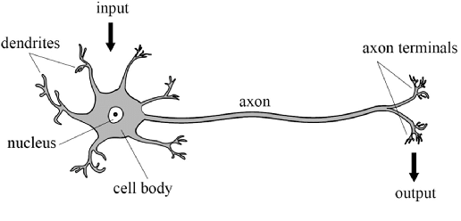
Biological Neuron
Nucleus (Soma/ Cell Body) processes inputs.
Dendrites are tree-like networks made of nerve fiber connected to the cell body. They accept input from neighbouring neuron through axon.
Axon is a single long fiber that serves as a transmission line carrying the impulses of neuron.
Synapse are the electrochemical contact between the organs. The synapse are said to be inhibitory or excitory.

Slide 6
Artificial Neural Network (ANN)
ANN is an efficient information processing system which resembles in characteristics with a biological neural network.
ANN is composed of a large number of highly interconnected processing elements called neurons working in unison to solve specific problems.
Widely used for pattern recognition and data classification.

Slide 7
Biological Neuron Vs ANN
 | Biological Neuron | Artificial Neural Network
Speed | Slow | Fast
Processing | Parallel Execution | One by one
Size and Complexity of Operation | Less | More, difficult to implement complex operation
Fault Tolerance | Exist | Doesn’t exist
Storage | If new data is added, old data is not erased | Erased
Control Mechanism | Every neuron acts independently | CPU

Slide 8
Advantages of ANN
Adaptive Learning: ANNs have the ability to do tasks after learning from experience gained from previous data.
Self-Organization: ANN is capable of organizing and representing information it receives from training data.
Real-Time Operation: ANN computations can be carried out in parallel. Special hardware devices can be designed and manufactured so that we can take advantage of this capability.
Fault Tolerance: If a neuron fails to work, the performance of the network will not stop, but it will give less accurate results.

Slide 9
Artificial Neural Networks Applications
Aerospace: Generally, we use ANN for Autopilot aircrafts. They are used for aircraft fault detection.
Military: In various ways, we use ANN in the military. Such as Weapon orientation and steering, target tracking.
Electronics: Basically, we use an Artificial neural network in electronics in many ways. That are code sequence prediction, IC chip layout, and chip failure analysis.
Medical: As medical has too many machines, ANN is used in various ways such as cancer cell analysis, EEG and ECG analysis.
Speech: We use ANN in speech recognition and speech classification.
Telecommunications: Generally, it has different applications such as image and data compression, automated information services.
Transportation: Generally, we use an Artificial neural network in transportation in many ways like truck Brake system diagnosis and vehicle scheduling, routing systems.
Software: It also uses an ANN in pattern Recognition such as in facial recognition, optical character recognition, etc.
Time Series Prediction: We use an Artificial neural network to predict time. Also, we use ANNs to make predictions on stocks and natural calamities.

Slide 10
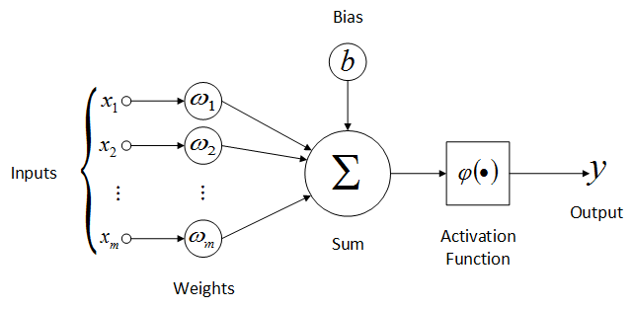
Mathematical Model of Artificial Neuron

Slide 11
PROCESSING OF AN ARTIFICIAL NET
The neuron is the basic information processing unit of a NN. It consists of:
A set of links, describing the neuron inputs, with weights W₁, W₂, …, W_{m}.
An adder function (linear combiner) for computing the weighted sum of the inputs (real numbers).
Bias value, which serves to increase or decrease the activation function input.
Activation function for limiting the amplitude of the neuron output to a predetermined range.

Slide 12
Neural Network Architecture
1. Feed Forward Neural Network
Single Layer Feed Forward Network
Multilayer Feed Forward Network
2. Recurrent Neural Network
Single Node with its own Feedback
Single Layer Recurrent Network
Multilayer Recurrent Network

Slide 13
Feed-forward Vs Recurrent Neural Network
If there is no “feedback” from the outputs of the neurons towards the inputs throughout the network, then the network is referred as a “feed-forward neural network”.
Otherwise, if there exists such a feedback, i.e. a synaptic connection from the outputs towards the inputs (either their own inputs or the inputs of other neurons), then the network is called a “recurrent neural network”.

Slide 14
Single Layer Feed Forward Network
In figure, a single layer feed-forward neural network (fully connected) is shown.
Including the input layer, there are two layers in this structure. However, input layer does not count because there is no computation performed in that layer.
Input signals are passed on to the output layer via the weights and the neurons in the output layer compute the output signals.

Slide 15
Multilayer Feed Forward Network
In figure aside, a multi-layer feed-forward neural network with one “hidden layer” is depicted.
As opposed to a single-layer network, there is (at least) one layer of “hidden neurons” between the input and output layers.
The function of hidden neurons is to intervene between the external input and the network output in some useful manner.
Existence of one or more hidden layers enable the network to extract higher-order statistics.
For the example given in figure, there is only one hidden layer and the network is referred as a 5-3-2 network because there are 5 input neurons, 3 hidden neurons, and 2 output neurons.

Slide 16
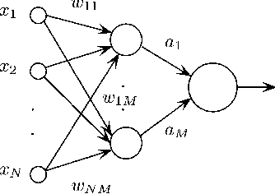
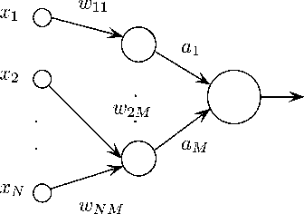
Networks are “fully connected” because every neuron in each layer is connected to every other neuron in the next forward layer.
If some of the synaptic connections were missing, the network would be called as “partially connected”.

Slide 17
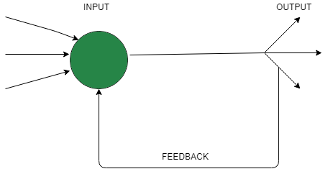
Single Node with its own Feedback
When outputs can be directed back as inputs to the same layer or preceding layer nodes, then it results in feedback networks.
Recurrent networks are feedback networks with closed loop.
Below figure shows a single recurrent network having single neuron with feedback to itself.

Slide 18
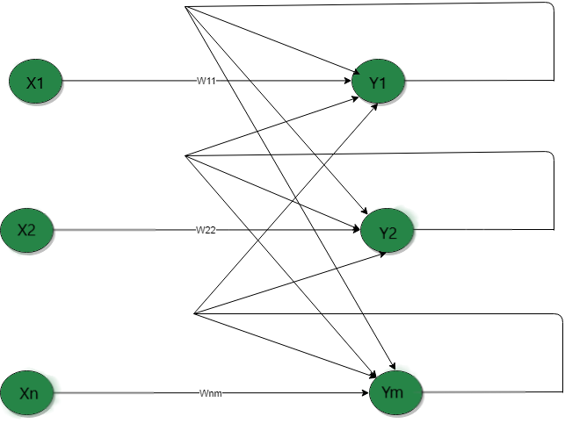
Single Layer Recurrent Network
Below network is single layer network with feedback connection in which processing element’s output can be directed back to itself or to other processing element or both.

Slide 19
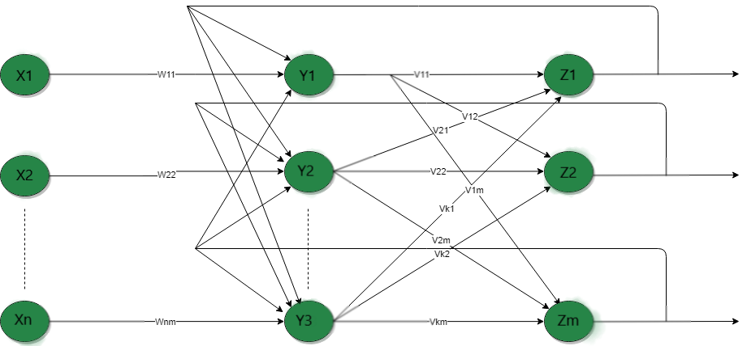
Multilayer recurrent network
In this type of network, processing element output can be directed to the processing element in the same layer and in the preceding layer forming a multilayer recurrent network.
They perform the same task for every element of a sequence, with the output being depended on the previous computations.
Inputs are not needed at each time step.

Slide 20
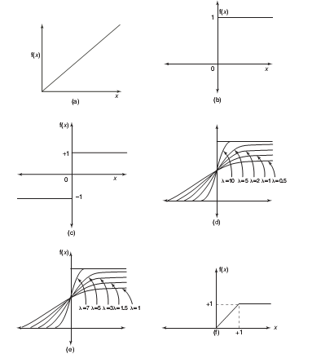
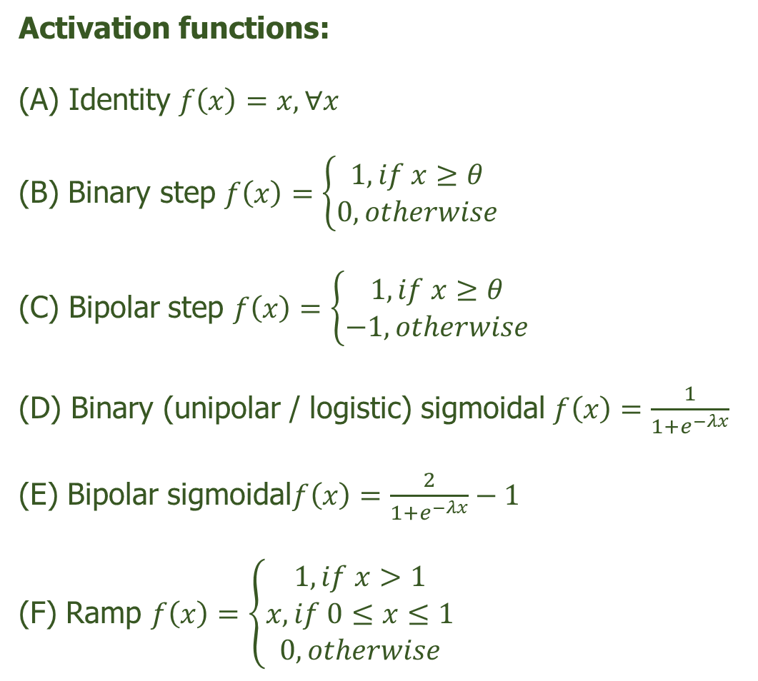
Activation Functions
Activation functions:
(A) Identity $f\left(x\right)=x, ∀x$
(B) Binary step $f\left(x\right)=\left\{\begin{matrix}1, if x≥θ \\ 0, otherwise\end{matrix}\right.$
(C) Bipolar step $f\left(x\right)=\left\{\begin{matrix}1, if x≥θ \\ −1, otherwise\end{matrix}\right.$
(D) Binary (unipolar / logistic) sigmoidal $f\left(x\right)=\frac{1}{1+e^{−λx}}$
(E) Bipolar sigmoidal$f\left(x\right)=\frac{2}{1+e^{−λx}}−1$
(F) Ramp $f\left(x\right)=\left\{\begin{matrix}1, if x>1 \\ x, if 0≤x≤1 \\ 0, otherwise\end{matrix}\right.$

Slide 21
McCulloch–Pitts Neural Network Model
The McCulloch–Pitt neural network is considered to be the first neural network.
The neurons are connected by directed weighted paths.
McCulloch–Pitt neuron allows binary activation (1 ON or 0 OFF), i.e., it either fires with an activation 1 or does not fire with an activation of 0.
If w > 0, then the connected path is said to be excitatory else it is known as inhibitory.
Excitatory connections have positive weights and inhibitory connections have negative weights.
Each neuron has a fixed threshold for firing.
That is, if the net input to the neuron is greater than the threshold, it fires.

Slide 22

McCulloch–Pitts Neuron Architecture
The architecture of the McCulloch–Pitts neuron is shown in figure.
“Y” is the McCulloch–Pitts neuron, it can receive signal from any number of other neurons.
The connection weights from X1...Xn are excitory, denoted by “w” and the connection weights from Xn+1...Xn+m are inhibitory denoted by “−p”.
The McCulloch–Pitts neuron Y has activation function as
Where θ is the threshold and yin is the total net input signal received by neuron Y.
The inhibition should be absolute. Hence, the threshold satisfies θ > nw−p.
The output neuron will fire if it receives k or more excitatory inputs with no inhibitory inputs, where kw ≥ θ> (k−1)w.

Slide 23
